Slide 1
Probabilities (&Simulation)
Xueping Li
Industrial & Systems Engineering
University of Tennessee, Knoxville

Slide 2
A VERY brief introduction
In R language
For Simulation

Slide 3
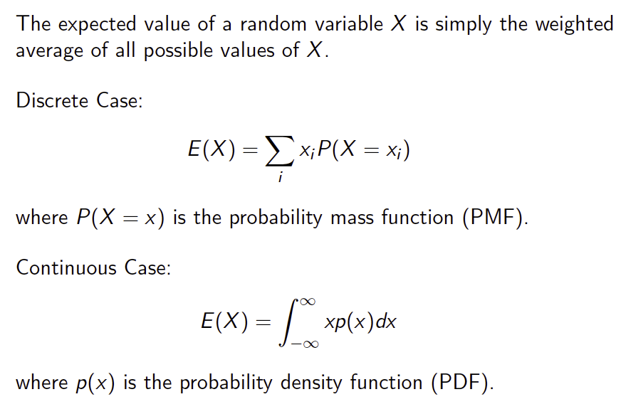
Expectation

Slide 4
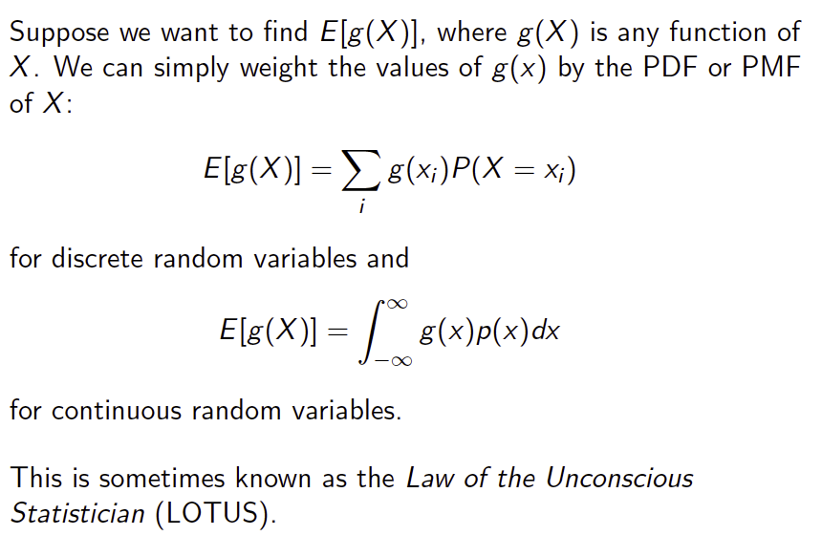
Expectation of a Function of a Random Variable

Slide 5
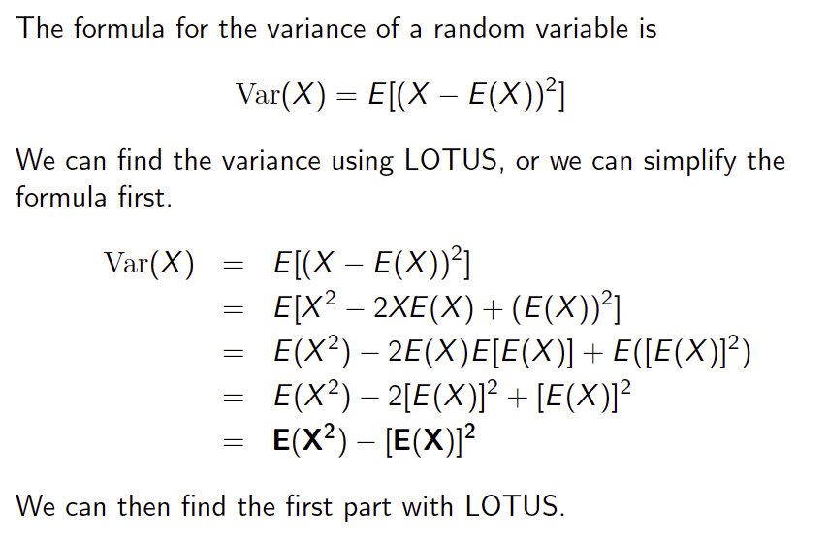
Variance

Slide 6
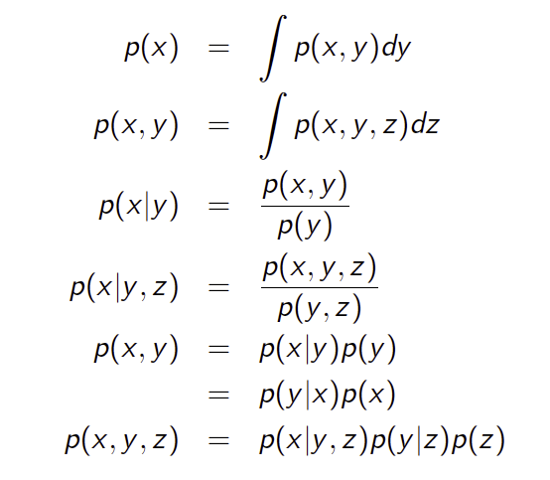
Marginal, Conditional, and Joint Densities

Slide 7
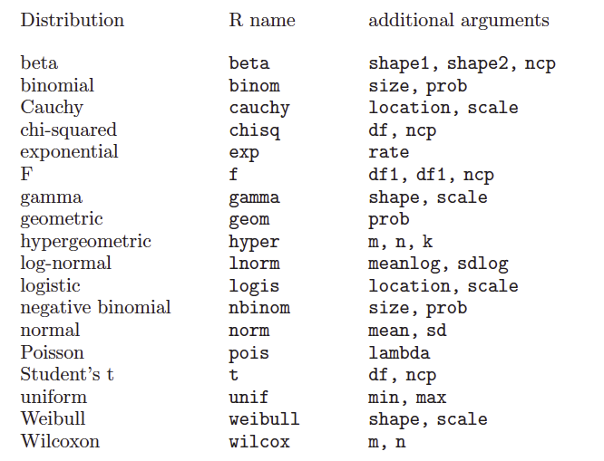
R functions

Slide 8
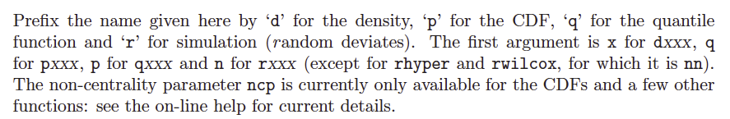
R Functions (cont.)
Notes:
Quantiles are values taken at regular intervals from the inverse function of the cumulative distribution function (CDF) of a random variable. Dividing ordered data into q essentially equal-sized data subsets is the motivation for q-quantiles; the quantiles are the data values marking the boundaries between consecutive subsets.

Slide 9
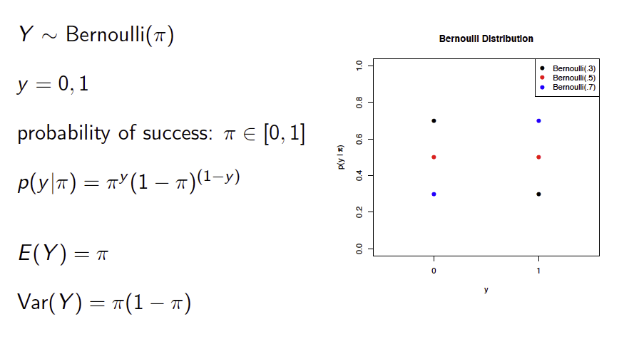
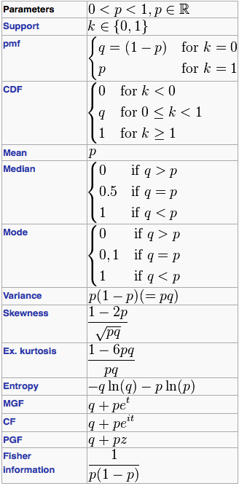
The Bernoulli Distribution
R practice
Notes:
For one toss of a coin, the probability of it being a HEAD (success)

Slide 10
Notation
Many ways - use π for the parameter

Slide 11
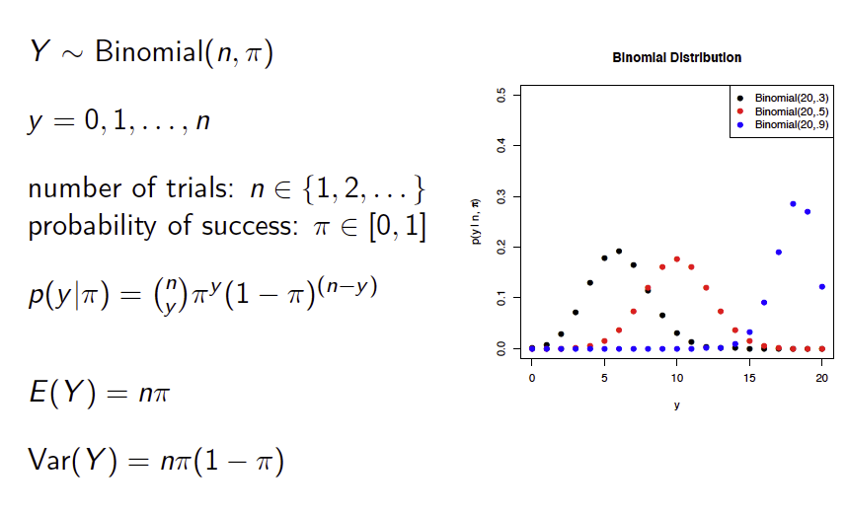
The Binomial Distribution
Notes:
C(n,y) = n!/(y!(n-y)!)

Slide 12
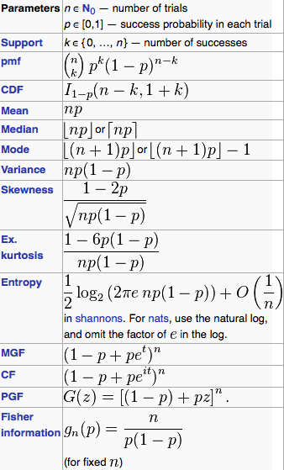
Cont.
R practice
Make a pdf curve
HIV drug response example (later)

Slide 13
R time! (Basic Distributions.R)
##The Bernoulli Distribution
pbinom(0,1,0.5)
pbinom(1,1,0.5)
pbinom(0,1,0.3)
pbinom(1,1,0.3)
## plot of pdf of binom
x=rbinom(1000,20,0.4)
plot(x,dbinom(x,20,0.4),type="p", col="red", main="plot of binom")
curve(dbinom(x,20,0.4), type="h", from=0, to=20)
pbinom(5,20,0.4) #with theta=0.4, CDF 5 successes in 20 trials
#[1] 0.125599
qbinom(0.5,20,0.4)
#[1] 8
…

Slide 14
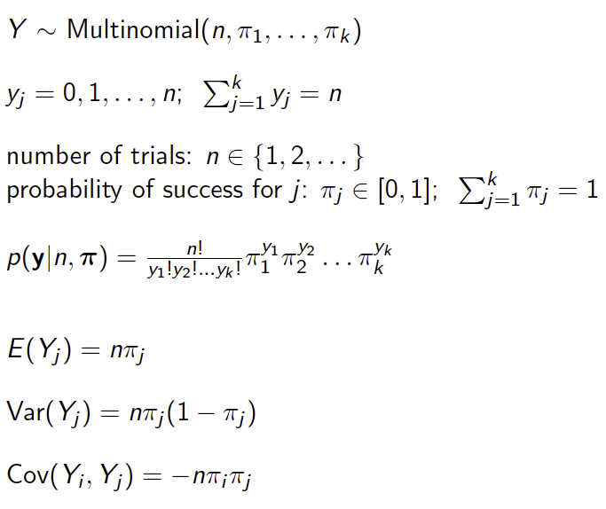
The Multinomial Distribution

Slide 15
Cont.
In a recent three-way election for a large country, candidate A received 20% of the votes, candidate B received 30% of the #votes, and candidate C received 50% of the votes. If six voters are selected randomly, what is the probability that there will be exactly one supporter for candidate A, two supporters for candidate B and three supporters for candidate C in the #sample?
ANSWER:________
Notes:
0.135

Slide 16
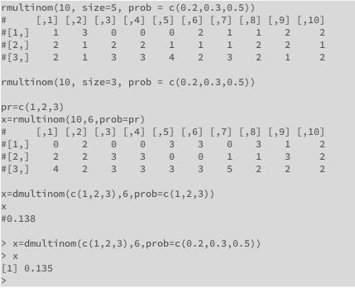
Cont.

Slide 17
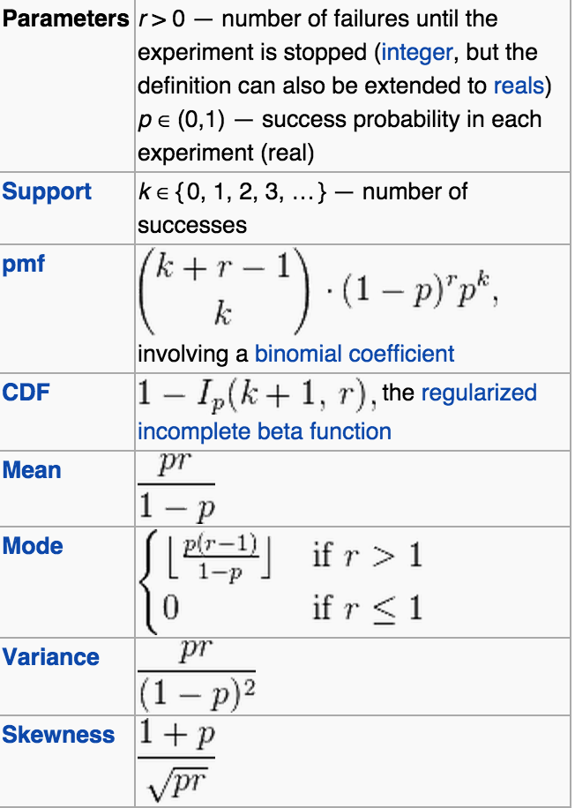
Negative Binomial Distribution
In probability theory and statistics, the negative binomial distribution is a discrete probability distribution of the number of successes in a sequence of independent and identically distributed Bernoulli trials before a specified (non-random) number of failures (denoted r) occurs.
Usually, we denote r+k=n
rnbinom()
ℙ(V_{k}=n)=C(n−1, k−1)p^{k}(1−p)^{n−k},n∈{k,k+1,k+2,…}
Q: how many tickets do I need to buy to win a lottery twice?

Slide 18
When k (success) is 1, this is Geometric Distribution
rgeom()
How many tickets do I need to buy to win a lottery?

Slide 19
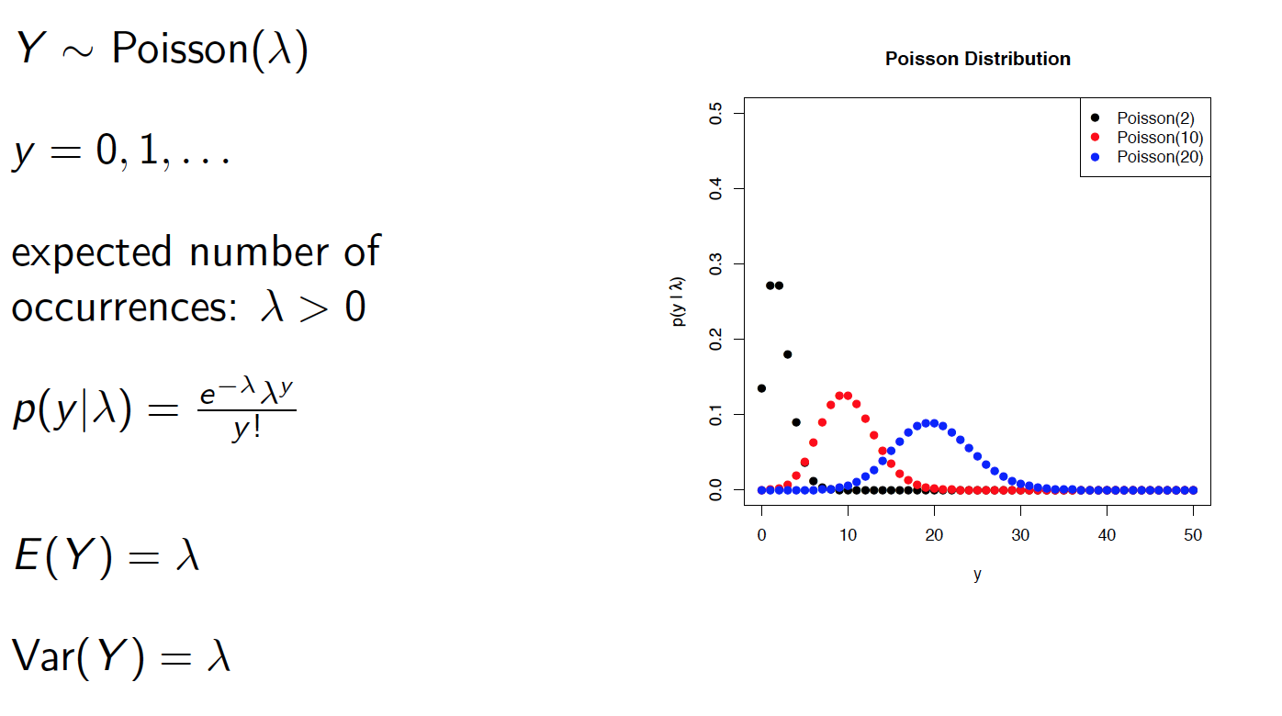
The Poisson Distribution

Slide 20
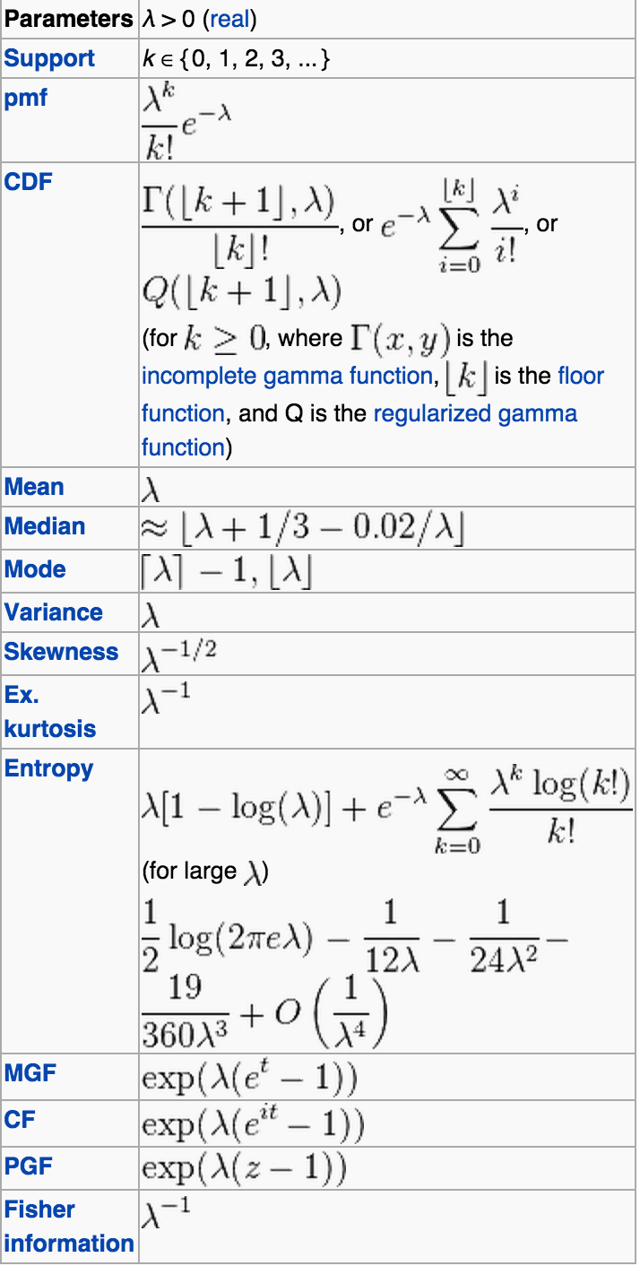
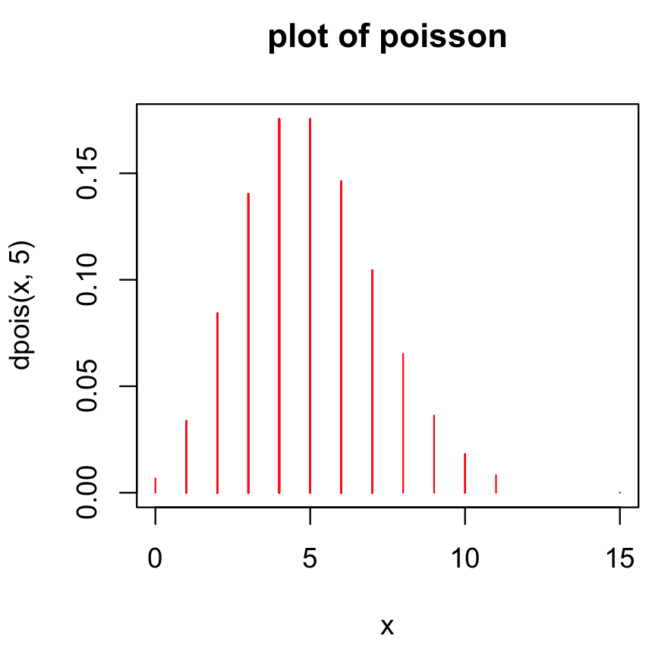
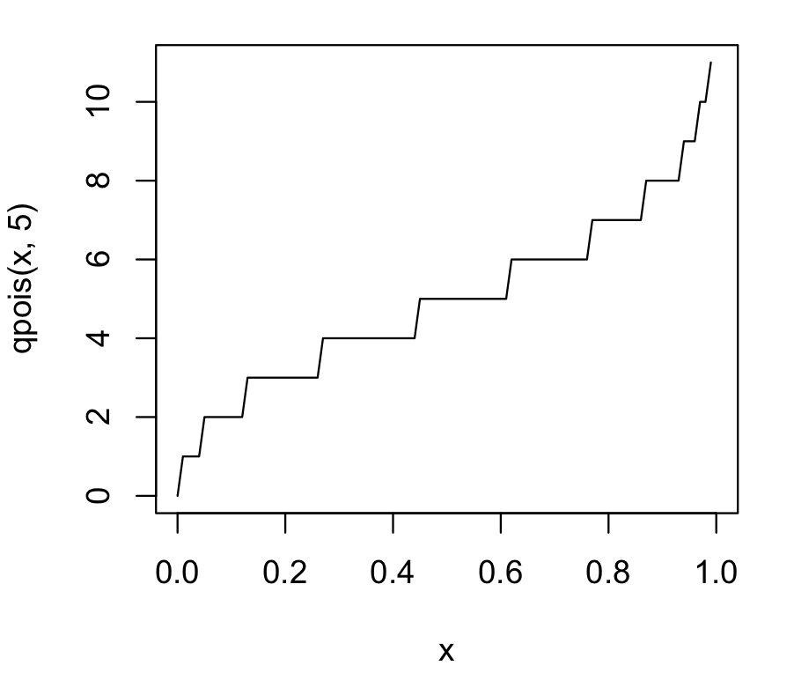
Cont.
R practice
Make a pdf curve
Make a cdf curve

Slide 21
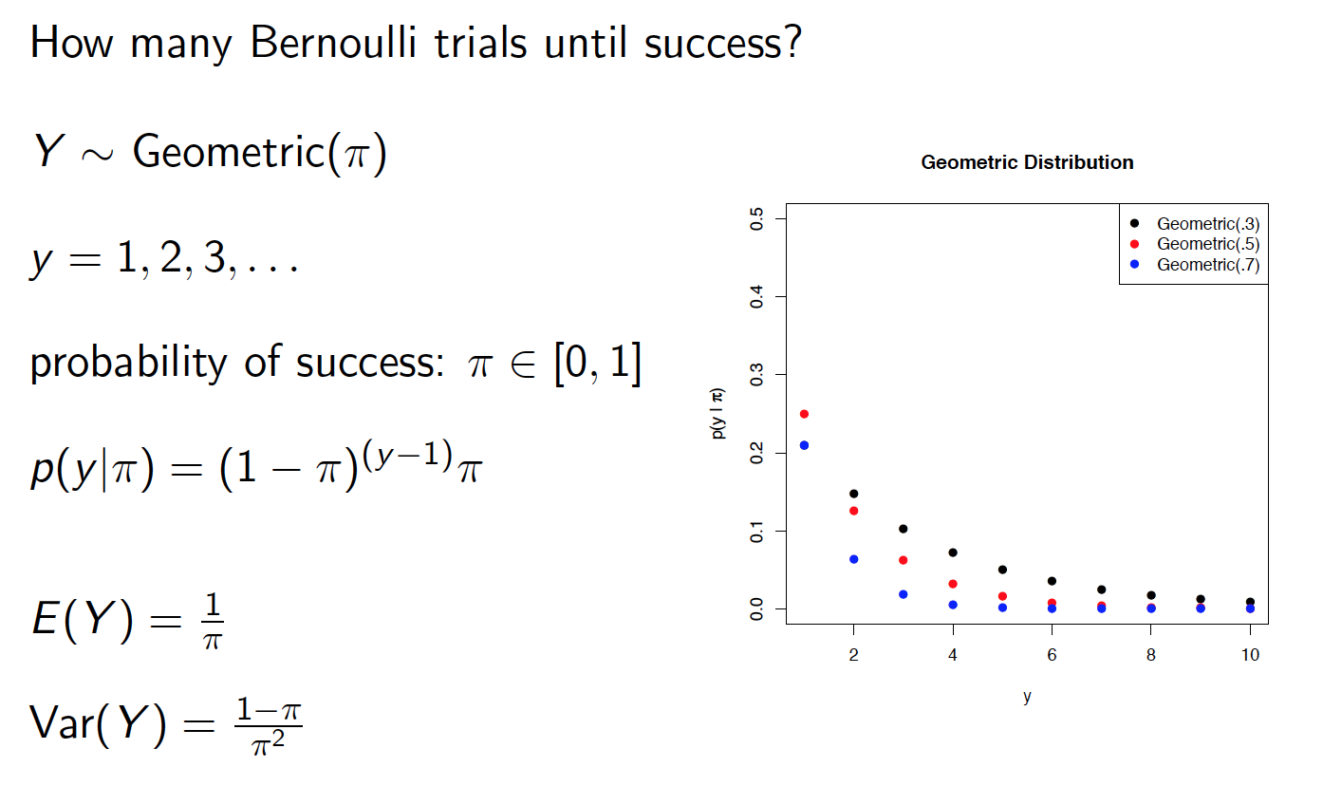
The Geometric Distribution

Slide 22
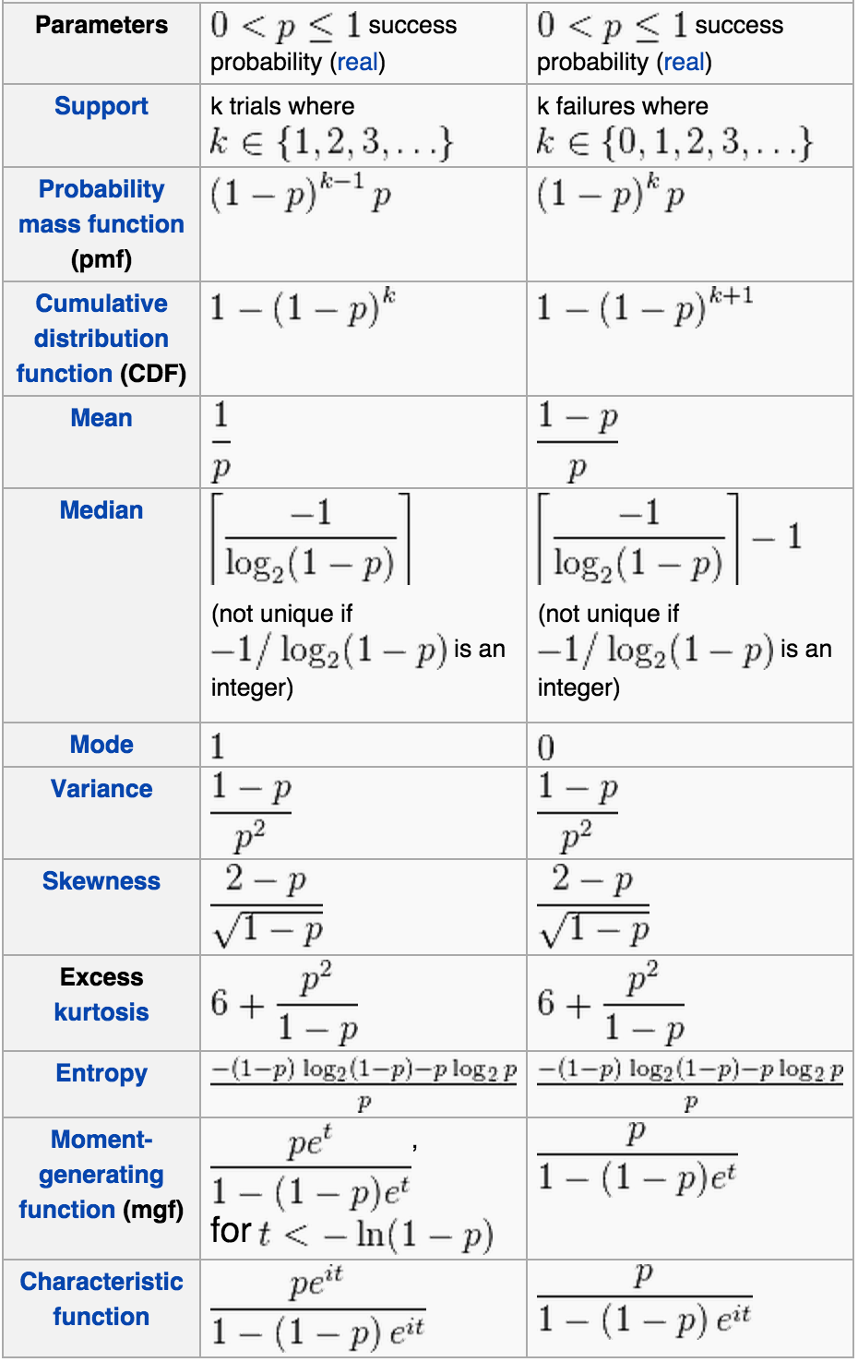
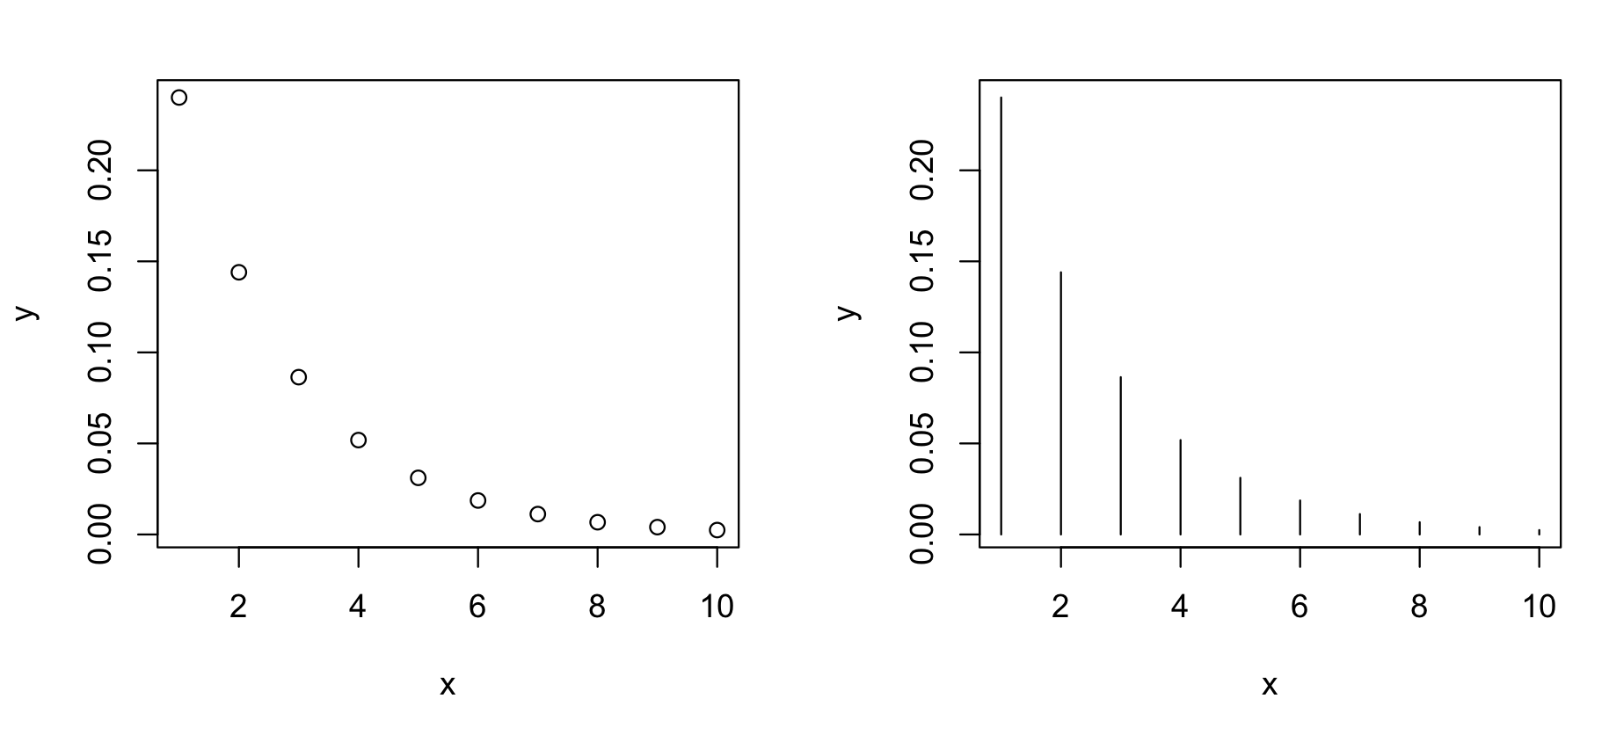
Cont.
R practice

Slide 23
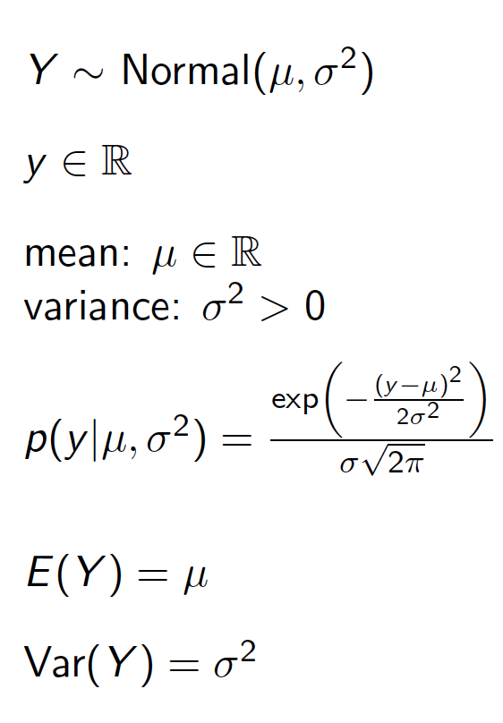
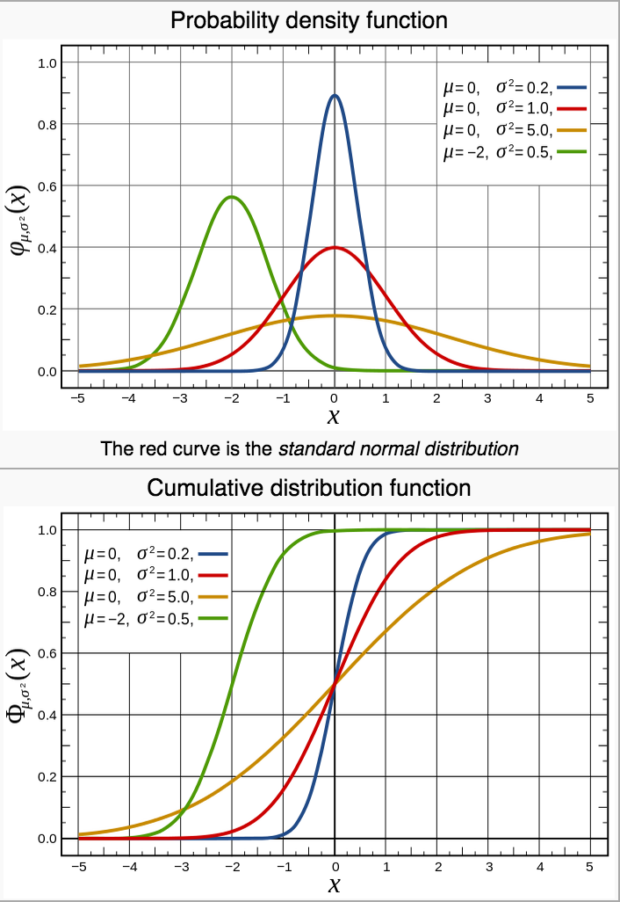
The Univariate Normal Distribution

Slide 24
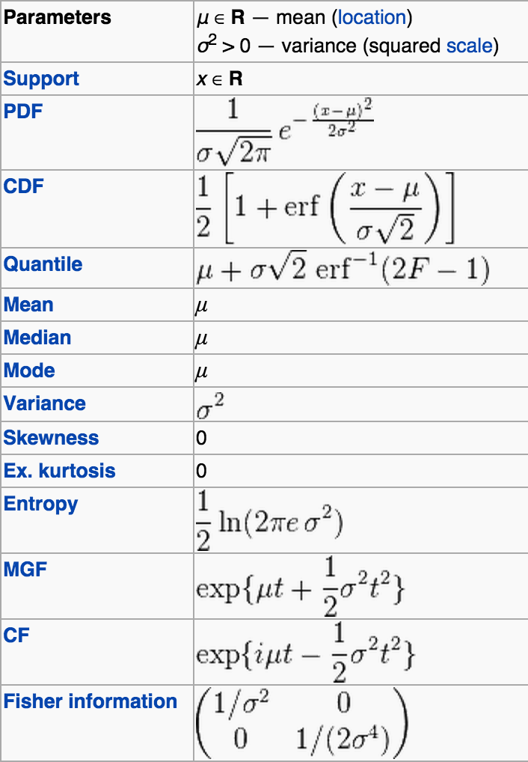
Cont.
Central Limit Theorem
Bayesian analysis
Do you know 6 Sigma?
R practice
2*pnorm(1)-1
#[1] 0.6826895 #+/- 1sigma
2*pnorm(2)-1
#[1] 0.9544997
2*pnorm(3)-1
#[1] 0.9973002
2*pnorm(4.5)-1
pnorm(4.5)
#[1] 0.9999966
pnorm(6,log=T)
#[1] -9.865876e-10

Slide 25
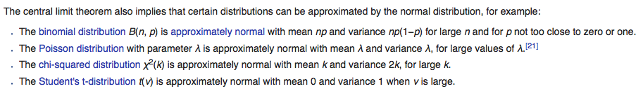
Cont.

Slide 26
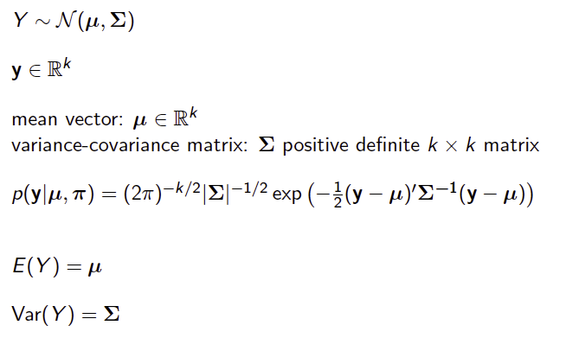
The Multivariate Normal Distribution

Slide 27
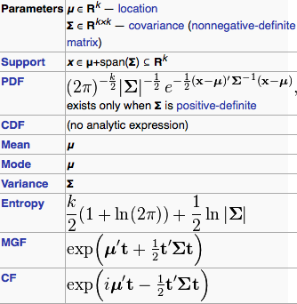
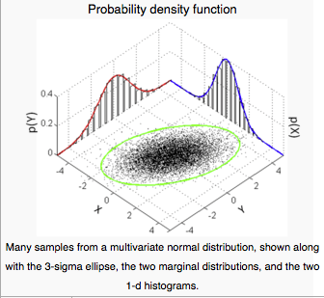
Cont.

Slide 28
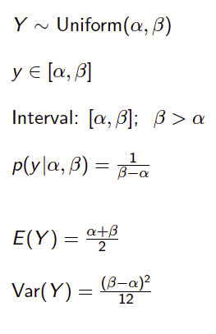
The Uniform Distribution

Slide 29
The Exponential distribution
In probability theory and statistics, the exponential distribution (a.k.a. negative exponential distribution) is the probability distribution that describes the time between events in a Poisson process, i.e. a process in which events occur continuously and independently at a constant average rate.
It is a particular case of gamma distribution. It is the continuous analogue of the geometric distribution, and it has the key property of being memoryless.

Slide 30
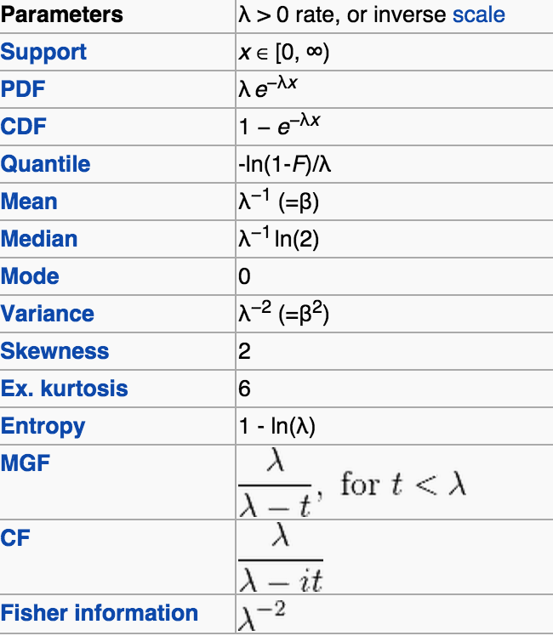
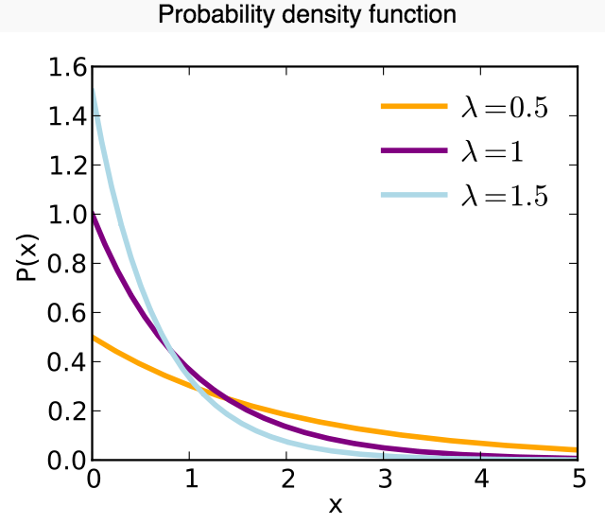
Exponential

Slide 31
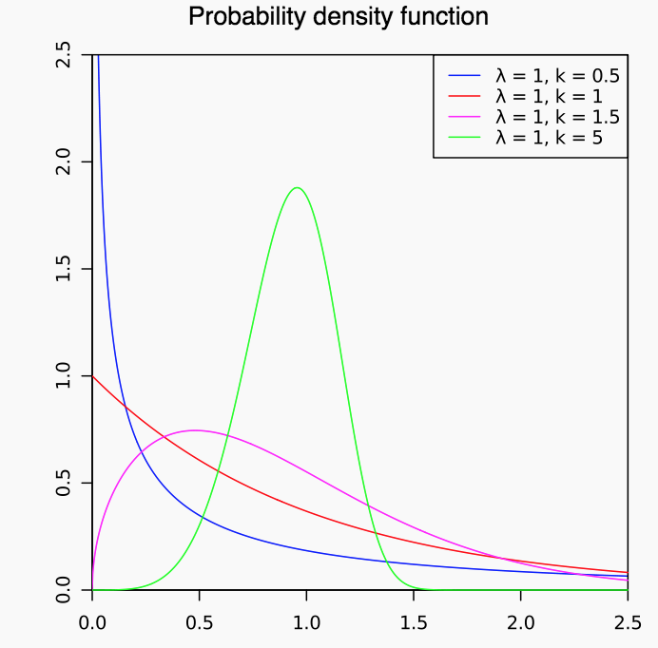
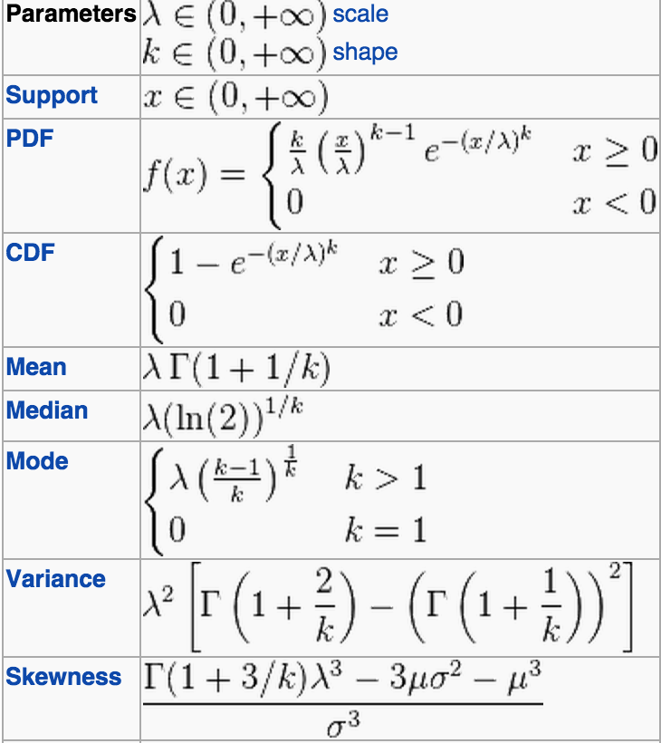
Weibull
If x ~ Exponential (lambda), then y = x^(1/alpha) has Weibull distribution with alpha and lambda

Slide 32
Exp. Cont.
If x1, …,xn is a sample from Exp(lambda), then x=x1 + …+ xn is Gamma(n, lambda)
The Family
https://en.wikipedia.org/wiki/Exponential_family

Slide 33
Exponential Family
The Bernoulli distribution is a one parameter exponential family in the success parameter p∈[0,1]
The beta distribution is a two-parameter exponential family in the shape parameters a∈(0,∞), b∈(0,∞).
The beta prime distribution is a two-parameter exponential family in the shape parameters a∈(0,∞), b∈(0,∞).
The binomial distribution is a one-parameter exponential family in the success parameter p∈[0,1] for a fixed value of the trial parameter n∈ℕ+.
The chi-square distribution is a one-parameter exponential family in the degrees of freedom n∈(0,∞).
The exponential distribution is a one-parameter exponential family (appropriately enough), in the rate parameter r∈(0,∞).
The gamma distribution is a two-parameter exponential family in the shape parameter k∈(0,∞) and the scale parameter b∈(0,∞).
The geometric distribution is a one-parameter exponential family in the success probability p∈(0,∞).
The half normal distribution is a one-parameter exponential family in the scale parameter σ∈(0,∞)

Slide 34
Exponential Family
The Laplace distribution is a one-parameter exponential family in the scale parameter b∈(0,∞) for a fixed value of the location parameter a∈ℝ.
The Lévy distribution is a one-parameter exponential family in the scale parameter b∈(0,∞) for a fixed value of the location parameter a∈ℝ.
The logarithmic distribution is a one-parameter exponential family in the shape parameter p∈(0,1)
The lognormal distribution is a two parameter exponential family in the shape parameters μ∈ℝ, σ∈(0,∞).
The Maxwell distribution is a one-parameter exponential family in the scale parameter b∈(0,∞).
The k-dimensional multinomial distribution is a k-parameter exponential family in the probability parameters (p1,p2,…,pk) for a fixed value of the trial parameter n∈ℕ+.
The k-dimensional multivariate normal distribution is a 12(k2+3k)-parameter exponential family with respect to the mean vector μ and the variance-covariance matrix V.

Slide 35
Exponential Family
The negative binomial distribution is a one-parameter exponential family in the success parameter p∈(0,1) for a fixed value of the stopping parameter k∈ℕ+.
The normal distribution is a two-parameter exponential family in the mean μ∈ℝ and the standard deviation σ∈(0,∞).
The Pareto distribution is a one-parameter exponential family in the shape parameter for a fixed value of the scale parameter.
The Poisson distribution is a one-parameter exponential family.
The Rayleigh distribution is a one-parameter exponential family.
The U-power distribution is a one-parameter exponential family in the shape parameter, for fixed values of the location and scale parameters.
The Weibull distribution is a one-parameter exponential family in the scale parameter for a fixed value of the shape parameter.
The zeta distribution is a one-parameter exponential family.
The Wald distribution is a two-parameter exponential family.
http://www.math.uah.edu/stat/special/GeneralExponential.html

Slide 36
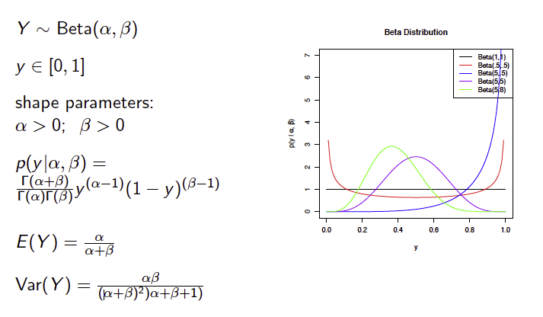
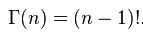
The Beta Distribution

Slide 37
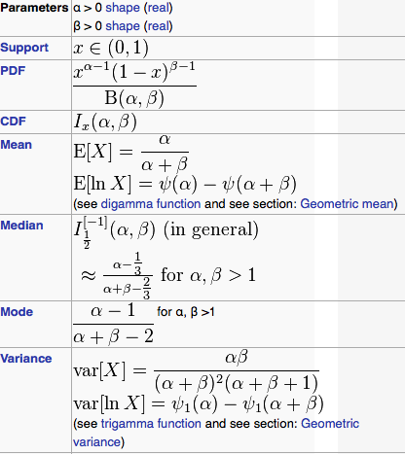
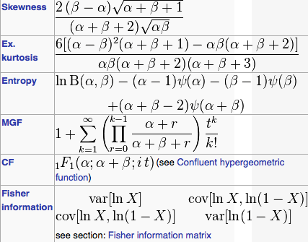
Cont.

Slide 38
Cont.
“In Bayesian inference, the beta distribution is the conjugate prior probability distribution for the Bernoulli, binomial, negative binomial and geometric distributions. For example, the beta distribution can be used in Bayesian analysis to describe initial knowledge concerning probability of success such as the probability that a space vehicle will successfully complete a specified mission. The beta distribution is a suitable model for the random behavior of percentages and proportions.” -Wiki
Example: HIV Drug

Slide 39
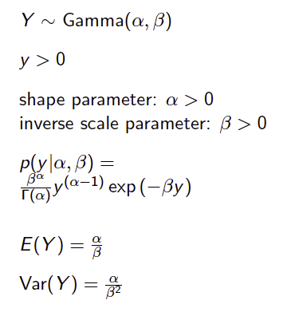
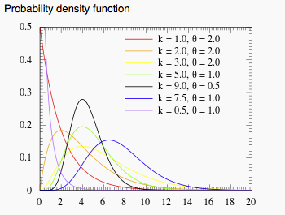
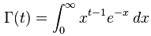
The Gamma Distribution

Slide 40
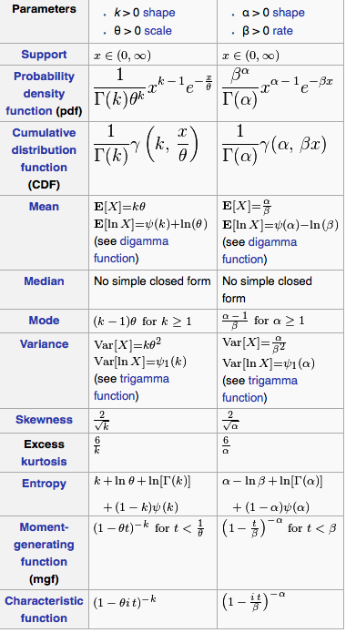
Cont.

Slide 41
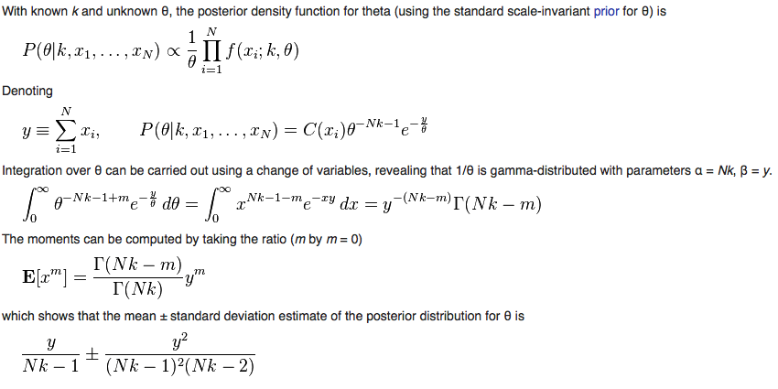
Cont. Bayesian minimum mean squared error

Slide 42
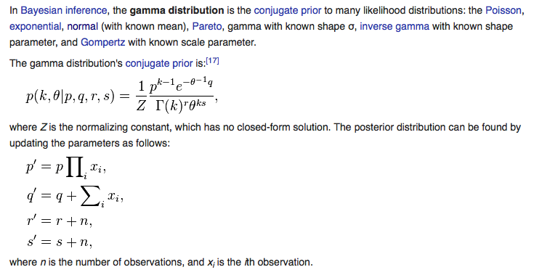
Cont. Conjugate Prior

Slide 43
Cont.
If X ~ Gamma(1, 1/λ) (shape -scale parametrization), then X has an exponential distribution with rate parameter λ.
If X ~ Gamma(ν/2, 2), then X is identical to χ2(ν), the chi-squared distribution with ν degrees of freedom.
If k is an integer, the gamma distribution is an Erlang distribution and is the probability distribution of the waiting time until the kth "arrival" in a one-dimensional Poisson process with intensity 1/θ.

Slide 44
Cont.
If X ~ Gamma(k, θ), then 1/X ~ Inv-Gamma(k, θ−1) (see Inverse-gamma distribution for derivation).
If X ~ Gamma(α, θ) and Y ~ Gamma(β, θ) are independently distributed, then X/(X + Y) has a beta distribution with parameters α and β.
If Xi ~ Gamma(αi, 1) are independently distributed, then the vector (X1/S, ..., Xn/S), where S = X1 + ... + Xn, follows a Dirichlet distribution with parameters α1, ..., αn.

Slide 45
Cont.
For large k the gamma distribution converges to Gaussian distribution with mean μ = kθ and variance σ² = kθ².
The gamma distribution is the conjugate prior for the precision of the normal distribution with known mean.

Slide 46
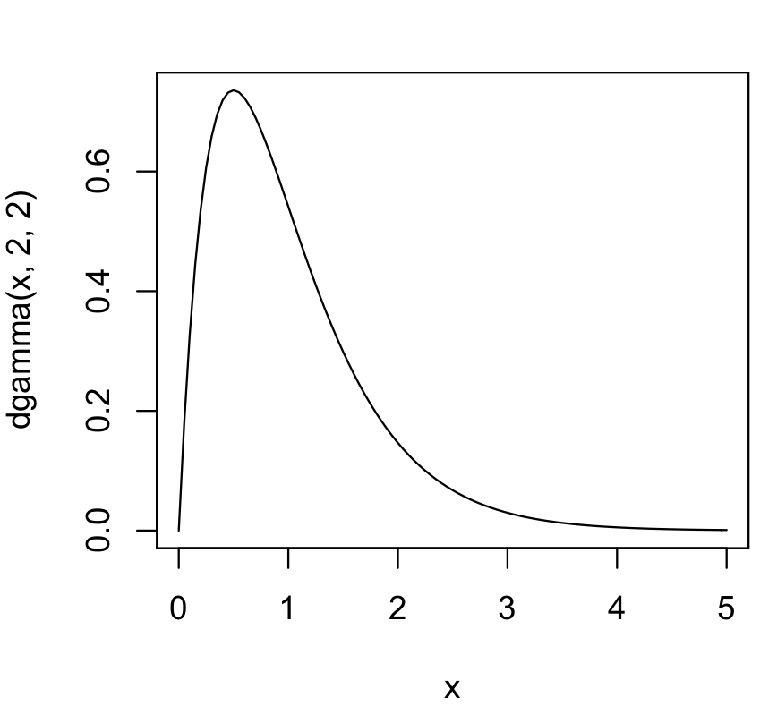
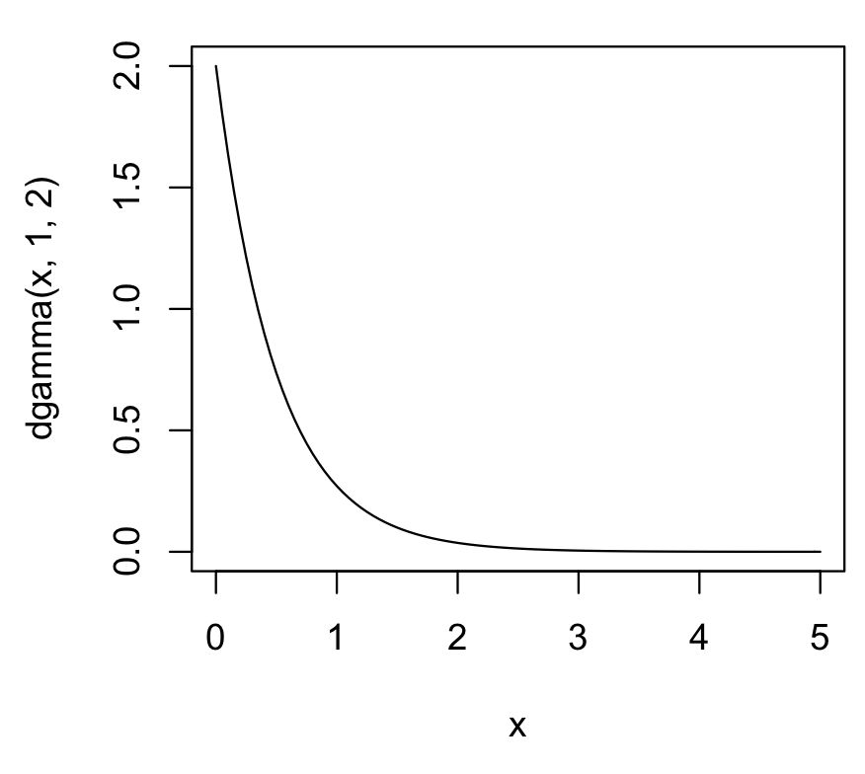
Example
R
Curve(dgamma(x,2,2),from=0,to=5)
curve(dgamma(x,1,2), from=0, to=5)

Slide 47
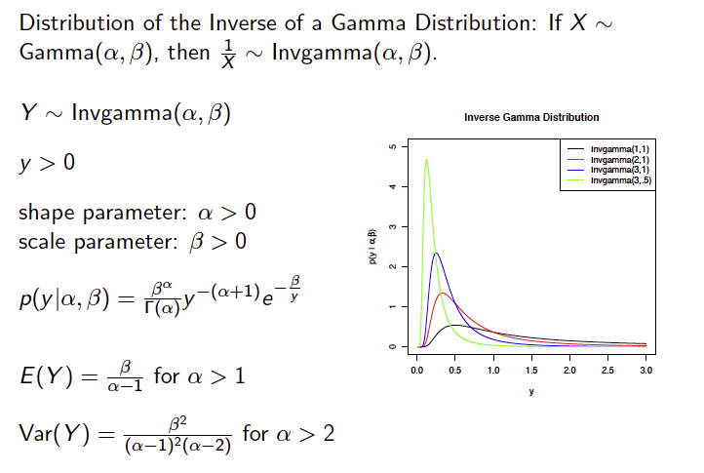
The Inverse Gamma Distribution

Slide 48
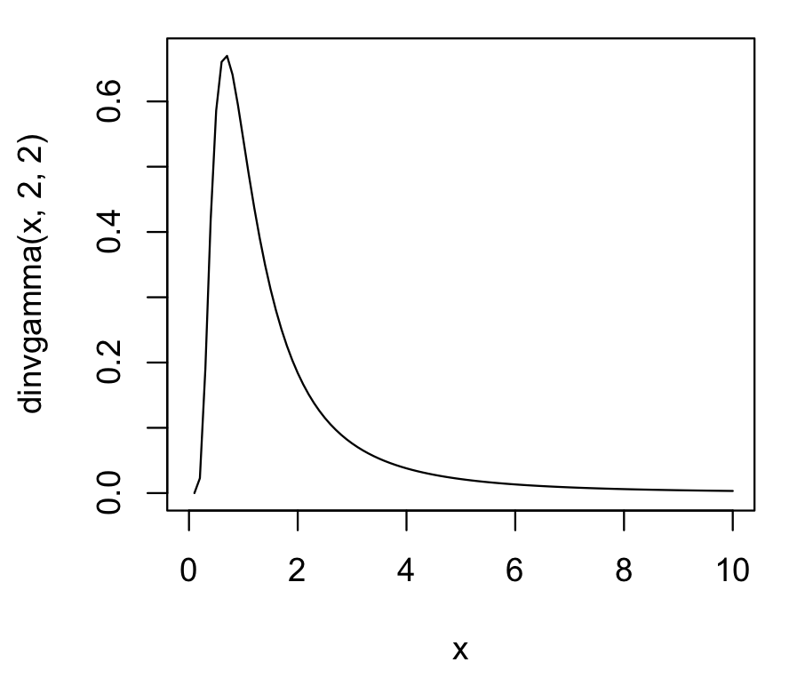
Cont.
R
curve(dinvgamma(x,2,2), from=0, to=10)

Slide 49
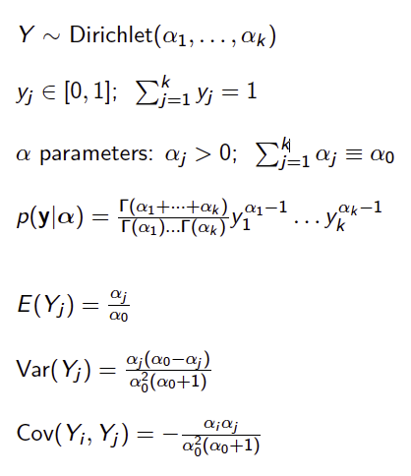
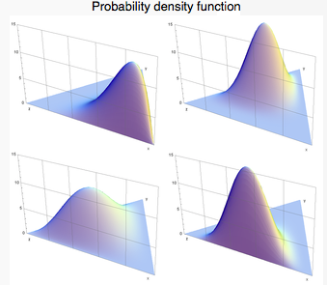
The Dirichlet Distribution

Slide 50
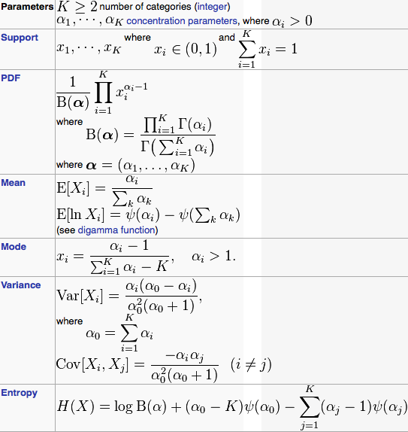
Cont.
Multivariate generalized the Beta distribution

Slide 51
Cont. Conjugate to categorical/multinomial
“The Dirichlet distribution is the conjugate prior distribution of the categorical distribution (a generic discrete probability distribution with a given number of possible outcomes) and multinomial distribution (the distribution over observed counts of each possible category in a set of categorically distributed observations). This means that if a data point has either a categorical or multinomial distribution, and the prior distribution of the distribution's parameter (the vector of probabilities that generates the data point) is distributed as a Dirichlet, then the posterior distribution of the parameter is also a Dirichlet.
Intuitively, in such a case, starting from what we know about the parameter prior to observing the data point, we then can update our knowledge based on the data point and end up with a new distribution of the same form as the old one. This means that we can successively update our knowledge of a parameter by incorporating new observations one at a time, without running into mathematical difficulties.”

Slide 52
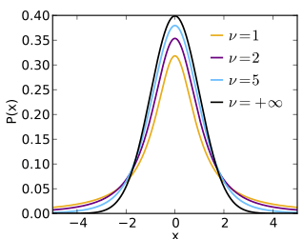
The Student’s T Distribution
“In the English-language literature it takes its name from William Sealy Gosset's 1908 paper in Biometrika under the pseudonym "Student”. Gosset worked at the Guinness Brewery in Dublin, Ireland, and was interested in the problems of small samples…”
…
It became well-known through the work of Ronald A. Fisher, who called the distribution "Student's distribution"

Slide 53


Cont.

Slide 54
Cont.
Related situations that also produce a t-distribution are:
The marginal posterior distribution of the unknown mean of a normally distributed variable, with unknown prior mean and variance following the above model.
The prior predictive distribution and posterior predictive distribution of a new normally distributed data point when a series of independent identically distributed normally distributed data points have been observed, with prior mean and variance as in the above model.

Slide 55

Cauchy distribution

Slide 56

Cont.
The standard Cauchy distribution coincides with the Student's t-distribution with one degree of freedom.
> rt(m,1)

Slide 57
More to explore …
Class Community Learning
Basic Distributions.R

Slide 58

Acknowledgement
Wikipedia.Org
Patrick Pam’s “Probability” handout

